Slide 1

SBA Loans
Explained
Understanding SBA 7(a) and 504 Loans
Presented by: Stephanie Thomas, SBA BDO
Hanover Bank
HANOVER BANK | SBA DIVISION
01

Slide 2




WHAT IS AN SBA LOAN?
—
SBA loans are partially guaranteed by the U.S. Small Business Administration
—
Issued by banks and CDCs, not directly by the SBA
—
Designed to help small businesses access affordable financing
—
Two most common programs: SBA 7(a) and SBA 504
"Helping small businesses grow through strategic federal guarantees."
HANOVER BANK | SBA DIVISION
02

Slide 3

SBA 7(a) Loan Program
THE MOST FLEXIBLE SOLUTION

Slide 4



7(A) USAGE AND PARAMETERS
Allowed Uses
Program Specs
—
Purchase or refinance commercial real estate
Max Amount: $5 Million
Guarantee: 75-85%
—
Working capital and operating expenses
Rates: Fixed or Variable
—
Business acquisition or partner buyout
Terms: 10 years (Working Cap/Equip) or 25 years (Real Estate)
—
Equipment and machinery purchases
—
Refinance existing business debt
Prohibited Uses
Investment or speculative purposes, Passive real estate, Paying delinquent taxes (unapproved), Personal expenses, Lending to others.
HANOVER BANK | SBA DIVISION
04

Slide 5
SBA 504 Loan Program
FIXED ASSET FINANCING

Slide 6


504 USAGE AND STRUCTURE
Typical Structure
Prohibited Uses
—
Working capital or inventory
50% Bank
40% SBA
10%*
Max SBA Portion: $5.5 Million
—
Business acquisition (no RE/Equip)
—
Owner-occupied commercial real estate purchases
—
Investment properties
—
Ground-up construction
—
Soft costs not tied to fixed assets
—
Heavy machinery (long useful life)
—
Short-term or revolving needs
—
Refinance eligible fixed assets
—
Must occupy at least 51% of existing property (60% for new construction)
*10% Borrower Equity (15–20% for special-purpose/startups)
HANOVER BANK | SBA DIVISION
06

Slide 7


INTEREST RATE MECHANICS
7(a) Calculation
504 Calculation
Bank Portion: Negotiated (Fixed/Variable)
SBA (CDC) Portion: Fixed rate based on U.S. Treasury bonds.Rate set at time of debenture sale
Result:
Blended interest rate that is often lower and more stable for long-term real estate holding.
*Spread capped by SBA based on size/term
*Can be variable (most common) or fixed
HANOVER BANK | SBA DIVISION
07

Slide 8
PROGRAM COMPARISON MATRIX
Feature | SBA 7(a) | SBA 504
Primary Use | Flexible / Working Cap / Buyouts | Fixed Assets / Real Estate
Max Loan Amount | $5,000,000 | $5,500,000 (SBA portion)
Interest Rates | Variable (Prime + Spread) | Fixed (Below Market)
Max Term | Up to 25 Years | Up to 25 Years
Best For | Cash flow, acquisitions, refinances | Real estate and heavy equipment
HANOVER BANK | SBA DIVISION
08

Slide 9






LENDER REQUIREMENTS: PART I
Credit Profile
Cash Flow
Management
Avg. score ≥ 680.
660 minimum with strong mitigants
Credit history acceptable (minimal late payments, collections, etc.)
No recent bankruptcies, foreclosures, or judgments.
Positive net worth.
Personal debt levels are reasonable
Historical DSCR ≥ 1.10x - 1.15x.
Projections must be reasonable and supported by market data.
Min. 3 years same-industry
or directly transferable experience. Adequate people management.
HANOVER BANK | SBA DIVISION
09

Slide 10

LENDER REQUIREMENTS: PART II
Basic Eligibility
Equity & Liquidity
—
Business is NOT in an SBA-ineligible industry (lending, speculation, gambling, cannabis, passive real estate)
—
Injection ≥ 10% true cash (not seller note only)
—
Post-transaction liquidity ≥ 10% of project cost and/or loan amount
—
Business is not engaged in illegal activity under federal law
—
Sources of funds must be verifiable
—
Meets SBA Size Standards
—
Meets SBA Size Standards
—
No delinquent federal debt (IRS/SBA/student loans)
—
Owners are US Citizens or Green Card holders
—
Min. 2 years business history
HANOVER BANK | SBA DIVISION
10

Slide 11
HANOVER DO NOT FUND LIST
Preferred Requests
Owner-Occupied CRE, Business Acquisitions, Partner Buyouts, Expansions, Equipment Purchase,
Franchise Leaseholds Improvements
HANOVER BANK | SBA DIVISION
10

Slide 12
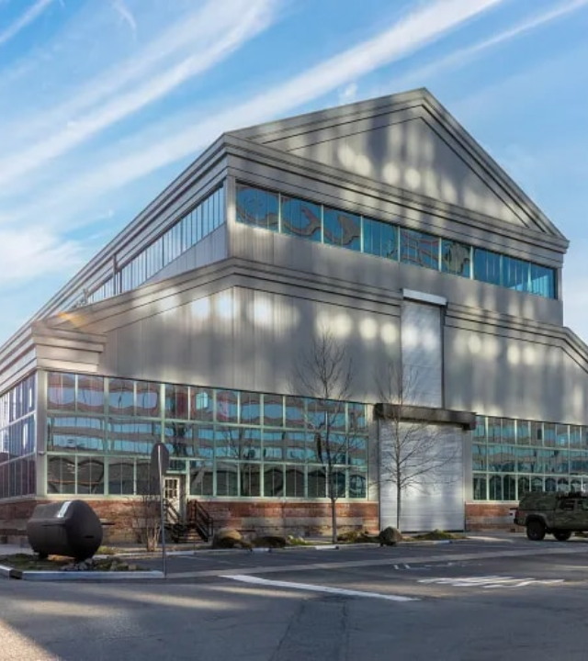


Which Loan is Right?
Choose 7(a) for maximum flexibility, working capital, and business acquisitions.
Choose 504 for long-term fixed asset financing and lower, stable rates.
A Lender can help structure the best option for your specific transaction.
HANOVER BANK | SBA DIVISION
12

Slide 13


Questions?
Thank you for your time and attention.
Stephanie Thomas
SBA BDO | Hanover Bank
HANOVER BANK | SBA DIVISION
13

Slide 14


IMAGE SOURCES
https://www.fsbwa.com/asset/6359c73ba1511?w=970&fit=max
Source: www.fsbwa.com
https://www.loopnet.com/s/images/types-of-commercial-real-estate/industrial-warehouse-in-brooklyn.webp
Source: www.loopnet.com

